Slide 1

Java
Server
Faces
Subject: Advanced Java Programming
Topic: JSF
This work is licensed under a Creative Commons Attribution-NonCommercial-ShareAlike 4.0 International License. You are free to use, distribute and modify it, for noncommercial purposes only, provided you acknowledge the source.

Slide 2
INTRODUCTION TO JSF
Java server pages is a web application framework used to develop the web application with rich user interface.
The framework is based on MVC – Model View Controller architecture.
It simplifies the construction of user interface (UI) component. These UI can interact with DB to store data.
In JSF, the UI component can be created by the use of Application programming Interface(API).

Slide 3
Benefits of JSF
JSF reduces the effort in creating and maintaining applications, which will run on a
Java application server and will render application UI on to a target client.
JSF facilitates Web application development by −
Providing reusable UI components
Making easy data transfer between UI components
Managing UI state across multiple server requests
Enabling implementation of custom components
Wiring client-side event to server-side application code

Slide 4
Benefits of JSF
Binding of UI components with some model data
Providing reusable UI components
Making easy data transfer between UI components
Managing UI state across multiple server requests
Enabling implementation of custom components
Handling different events on UI component on server- side
Validating user-inputs
Defining navigation rule

Slide 5
JSF ARCHITECTURE
A JSF application is similar to any other Java technology- based web application; it runs in a Java servlet container, and contains
JavaBeans components as models containing application-specific functionality and data
A custom tag library for representing event handlers and validators
A custom tag library for rendering UI components
UI components represented as state-ful objects on the server
Server-side helper classes
Validators, event handlers, and navigation handlers
Application configuration resource file for configuring application resources.

Slide 6
JSF ARCHITECTURE
JSF technology is a framework for developing, building server-side User Interface Components and using them in a web application.
JSF technology is based on the Model View Controller (MVC) architecture for separating logic from presentation
What is MVC Design Pattern?
Model : Carries Data and login
View : Shows User Interface
Controller : Handles processing of an application.

Slide 7
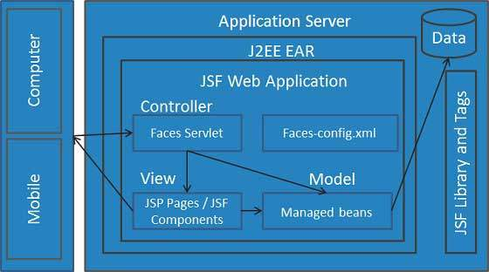
JSF ARCHITECTURE CONTINUED…
User submit the request to the application server using web browser. This request is received by JSF Faces Servlet. This servlet is a part of JSF Web Application and it need not be written. It basically acts as controller. It routes the request to appropriate page. It can read config.xml file.
The managed beans contains the form data which can access the backend or Db to retrieve desired data for processing the request. The managed bean acts as a Model.

Slide 8
JSF ARCHITECTURE CONTINUED…
The Face Servlet will determine and route the request to appropriate page for display information. Typically these web pages are in the xhtml file. This part acts as view.
Finally the web page is rendered and sent back to the web browser.

Slide 9
JSF elements
UI Component
Renderer
Validator
Backing Beans
Convertor
Event and Listeners
Message
Navigation

Slide 10
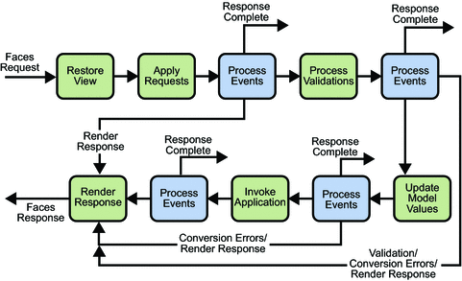
JSF LIFE CYCLE:

Slide 11
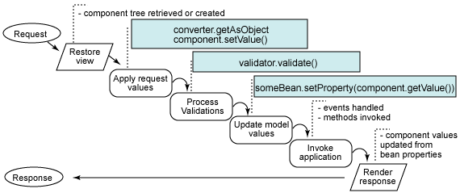

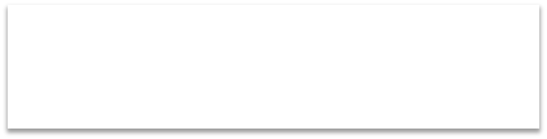

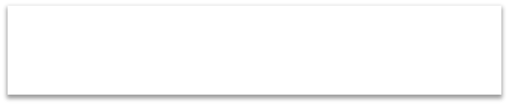


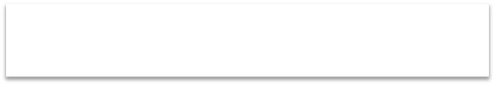

JSF LIFE CYCLE:
Submitted form values stored in
component, Component values converted
Component values calculated
Component values bound to backing beans

Slide 12
Six phases of JSF request processing life-cycle
The Restore View Phase
The Apply Request Values Phase
The Process Validation Phase
Update Model View Phase
The invoke Application Phase
The Render Response Phase

Slide 13
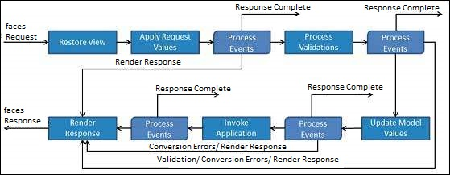
JSF LIFE CYCLE:
Restore View: This is the first phase in JSF Request processes life cycle. This phase is used for constructing view to display the front end. This view is stored in FacesContext instance and using this information request can be processed.
Apply request Values: After the component tree is created, each component in the component tree extracts its new value from the request parameters. Component stores this value. If the conversion fails, an error message is generated and queued on FacesContext. This message will be displayed during the render response phase, along with any validation errors.

Slide 14
JSF LIFE CYCLE CONTINUED…
Process validation : During this phase, JSF processes all validators registered on the component tree.
Update model values: After the JSF checks that the data is valid, it walks over the component tree and sets the corresponding server-side object properties to the components local values.

Slide 15
JSF LIFE CYCLE CONTINUED…
Invoke application: During this phase, JSF handles any application-level events, such as submitting a form/linking to another page.
Render response: During this phase, JSF asks container / application server to render the page if the application is using JSP pages. After the content is rendered.

Slide 16
JSF UI Component Model
JSF provides the developers with the capability to create Web application from collections of UI components that can render themselves in different ways for multiple client types (for example - HTML browser, wireless, or WAP device).
JSF provides
Core library
A set of base UI components - standard HTML input elements
Extension of the base UI components to create additional UI component libraries or to extend existing components
Multiple rendering capabilities that enable JSF UI components to render themselves differently depending on the client types

Slide 17
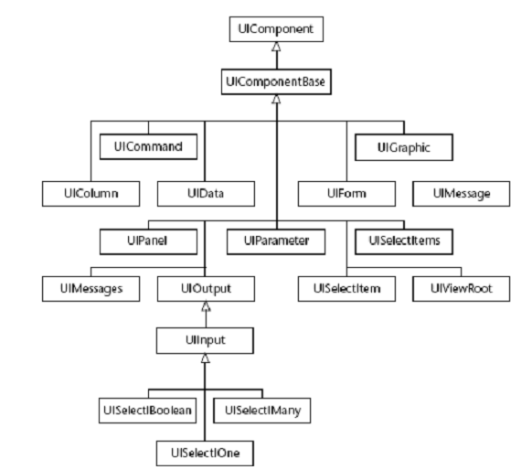
JSF standard UI components

Slide 18
Two types of JSF Tag library:
1.Core Tag Library:
Defines the tag that perform core actions.This tag library does not depend upon specific render kit.
We can use these tag libraries in JSP page as follows:
<%@taglib uri=" http://java.sun.com/jsf/core" prefix=" f"
%>
For these tags you need to use the following namespaces of URI in html node.
<html xmlns="http://www.w3.org/1999/xhtml" xmlns:f="http://java.sun.com/jsf/core" >

Slide 19
Two types of JSF Tag library (cont.):
2.Html Tag Library:
Defines the tags that represent general HTML UI components.
These html components include:
HtmlInputText, HtmlInputTextarea, HtmlForm and HtmlCommandButton.
<%@taglib uri=" http://java.sun.com/jsf/html" prefix=" h" %>
JSF provides a standard HTML tag library. These tags get rendered into corresponding html output.
For these tags you need to use the following namespaces of URI in html node.
<html xmlns="http://www.w3.org/1999/xhtml" xmlns:h="http://java.sun.com/jsf/html" >

Slide 20
2.Html Tag Library:
Defines the tags that represent general HTML UI components.These html components include
HtmlInputText,HtmlInputTextarea,HtmlForm HtmlCommandButton.
and
<%@taglib uri=" http://java.sun.com/jsf/html" h" %>
prefix="
JSF provides a standard HTML tag library. These tags get rendered into corresponding html output.
For these tags you need to use the following namespaces of URI in html node.
<html xmlns="http://www.w3.org/1999/xhtml" xmlns:h="http://java.sun.com/jsf/html" >

Slide 21
JSF STANDARD COMPONENT:
JSF <h:inputText>Tag
JSF <h:outputText> Tag
JSF <h:form> Tag
JSF <h:commandButton> Tag

Slide 22
1 JSF <h:inputText>Tag
The JSF <h: inputText> tag is used to render an input field on the web page.
It is used within a <h: form> tag to declare input field that allows user to input data.
<h:inputText id="sid-id" value="#{student.id}"/>
Attribute name | Description
Id | It is an identifier for this component. This id must be unique. You can use it to access HTML element in CSS and JS file.
Value | It is used to collect present value of the inputText.
maxlength | The maximum number of characters that may be entered in this field.
size | The number of characters used to determine the width of this field .

Slide 23
2 JSF - <h:selectOneMenu>
The h:selectOneMenu tag renders an HTML input element of the type "select" with size not specified.
<h:selectOneMenu value = "#{student.city}">
<f:selectItem itemValue = "1" itemLabel = "UNJHA" />
<f:selectItem itemValue = "2" itemLabel = "MEHSANA" />
<f:selectItem itemValue = "3" itemLabel = "KADI" />
<f:selectItem itemValue = "4" itemLabel = "VISHNAGAR" />
</h:selectOneMenu>

Slide 24
3 JSF <h:outputText> Tag
It is used to render a plain text.
<h:outputText value="hello"></h:outputText>
Attribute | Description
Value | It holds current value of this component.
Id | It is an identifier for this component. This id must be unique. You can use it to access HTML element in CSS and JS file.
style | It is used to apply CSS for the component.
class | It gives class name to the component. It is used to access component from CSS and JS file.
lang | It is used to specify language. It helps to make web page localized.

Slide 25
4 JSF <h:form> Tag
The <h:form> tag represents an input form.
It includes child components that can contain data which is either presented to the user or submitted with the form.
It can also include HTML markup to lay out the components on the page.
<h:form>
<!-- form elements -->
</h:form>

Slide 26
5 JSF <h:commandButton> Tag
It creates a submit button and used to submit a application form.
You can create it by using the following syntax.
<h:commandButton value="Submit“ action="response.xhtml"> </h:commandButton>

Slide 27
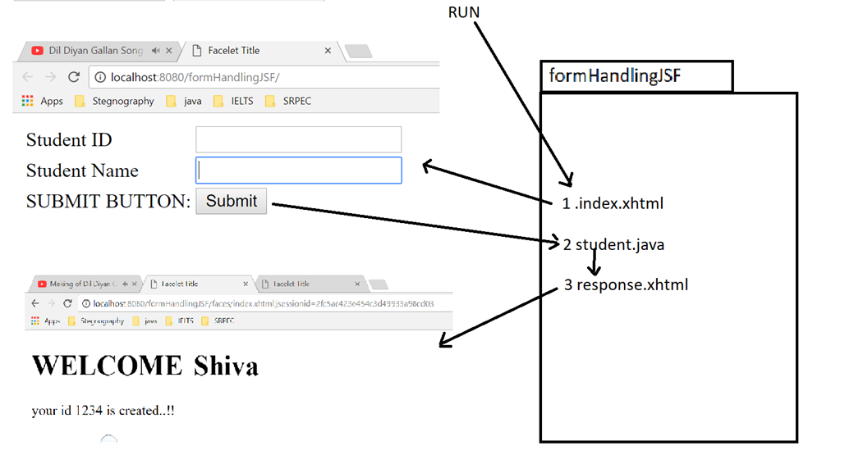
PROG 0 : JSF FORM HANDLING EXAMPLE:

Slide 28
PROG 0: FILES NEED TO BE CREATED
Total 3 file need to be created
index.xhtml
Student.java
response.xhtml

Slide 29
1. Index.xhtml
<?xml version='1.0' encoding='UTF-8' ?>
<!DOCTYPE html>
<html xmlns="http://www.w3.org/1999/xhtml"
xmlns:h="http://xmlns.jcp.org/jsf/html">
<h:head>
<title>Facelet Title</title>
</h:head>
<h:body>
<h:form>
<table>
<tr>
<td>Student ID</td>
<td><h:inputText id="sid-id" value="#{student.id}"/></td>
</tr>

Slide 30
1. Index.xhtml
<tr>
<td>Student Name</td>
<td><h:inputText id="sname-id" value="#{student.name}"/></td>
</tr>
<tr>
<td>SUBMIT BUTTON:</td>
<td><h:commandButton value="Submit" action="response.xhtml"></h:commandButton></td>
</tr>
</table>
</h:form>
</h:body>
</html>

Slide 31
2. student.java JSF MANAGED BEAN: JAVA CLASS
import javax.annotation.ManagedBean;
import javax.enterprise.context.ApplicationScoped;
import javax.inject.Named;
@Named("student")
@ManagedBean
@ApplicationScoped
public class student {
int id;
String name;
public int getId() {
return id;
}
public void setId(int id)
{
this.id = id;
}
public String getName() {
return name;
}
public void setName(String name) {
this.name = name;
}
}

Slide 32
3 response.xhtml
<?xml version='1.0' encoding='UTF-8' ?>
<!DOCTYPE html >
<html xmlns="http://www.w3.org/1999/xhtml"
xmlns:h="http://xmlns.jcp.org/jsf/html">
<h:head>
<title>Facelet Title</title>
</h:head>
<h:body>
<h1> WELCOME <h:outputText value="#{student.name}"> </h:outputText></h1>
your id <h:outputText value="#{student.id}"> </h:outputText> is created..!!
</h:body>
</html>

Slide 33
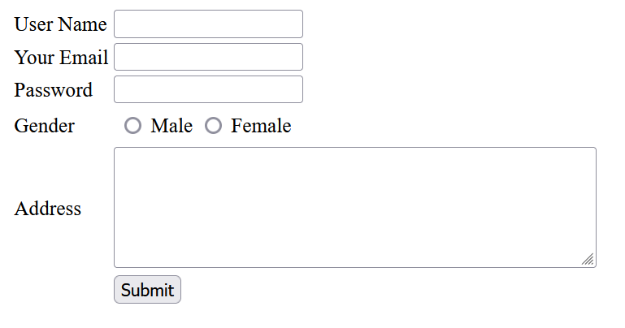
PROG 1: JSF COMPONENTS

Slide 34
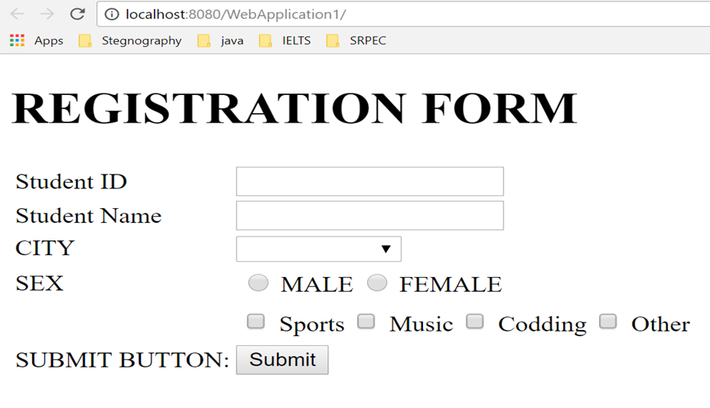
PROG 1: JSF COMPONENTS

Slide 35
<?xml version='1.0' encoding='UTF-8' ?>
<!DOCTYPE html>
<html xmlns="http://www.w3.org/1999/xhtml"
xmlns:h="http://xmlns.jcp.org/jsf/html"
xmlns:f="http://xmlns.jcp.org/jsf/core">
<h:head>
<title>Facelet Title</title>
</h:head>
<h:body>
<h1>REGISTRATION FORM</h1>
<h:form>
<table>
<tr>
<td>Student ID</td>
<td><h:inputText id="sid-id" value="#{student.id}"/></td>
</tr>
<tr>
<td>Student Name</td>
<td><h:inputText id="sname-id" value="#{student.name}"/></td>
</tr>
<tr>
<td>CITY</td>
<td>
<h:selectOneMenu value = "#{student.city}">
<f:selectItem itemValue = "1" itemLabel = "Rajkot" />
<f:selectItem itemValue = "2" itemLabel = "Ahemdabad" />
<f:selectItem itemValue = "3" itemLabel = "Baroda" />
<f:selectItem itemValue = "4" itemLabel = "Surat" />
</h:selectOneMenu>
</td>
</tr>
<tr>
<td>SEX</td>
<td>
<h:selectOneRadio value = "#{student.sex}">
<f:selectItem itemValue = "1" itemLabel = "MALE" />
<f:selectItem itemValue = "2" itemLabel = "FEMALE" />
</h:selectOneRadio>
</td>
</tr>
<tr>
<td>Hobby:</td>
<td>
<h:selectManyCheckbox value = "#{student.hobby}">
<f:selectItem itemValue = "1" itemLabel = "Sports" />
<f:selectItem itemValue = "2" itemLabel = "Music" />
<f:selectItem itemValue = "3" itemLabel = "Codding" />
<f:selectItem itemValue = "4" itemLabel = "Other" />
</h:selectManyCheckbox>
</td>
</tr>
<tr>
<td>SUBMIT BUTTON:</td>
<td><h:commandButton value="Submit" action="response.xhtml"></h:commandButton></td>
</tr>
</table>
</h:form>
</h:body>
</html>

Slide 36
JSF EXPRESSION LANGUAGE:
JSF expression language allows the user to access the data dynamically form the java Bean component.
JSF provides rich expression language.
We can provide normal operation using #{operation-expression} notation
These expression can be of two types
Property expression:
#{<beanName>.<property>}
Method expression:
#{<beanName>.<method>}

Slide 37
JSF EXPRESSION LANGUAGE ADVANTAGES
Can reference bean properties where bean can be an object stored in request, session or application scope or is a managed bean.
Provides easy access to elements of a collection which can be a list, map or an array.
Provides easy access to predefined objects such as a request.
Arithmetic, logical and relational operations can be done using expression language.
Automatic type conversion.
Shows missing values as empty strings instead of NullPointerException.

Slide 38
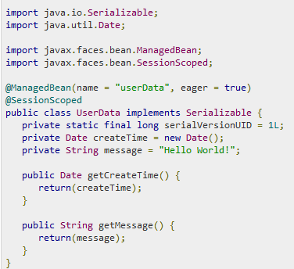
JSF EXPRESSION LANGUAGE EXAMPLE:
UserData.java

Slide 39
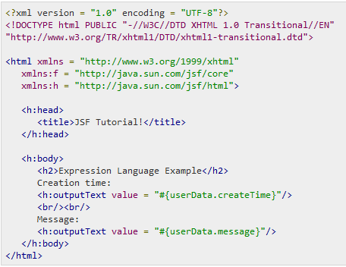
JSF EXPRESSION LANGUAGE EXAMPLE:
home.xhtml

Slide 40
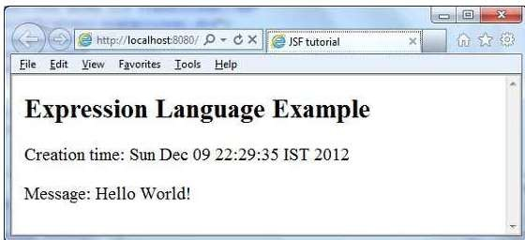
JSF EXPRESSION LANGUAGE EXAMPLE:

Slide 41
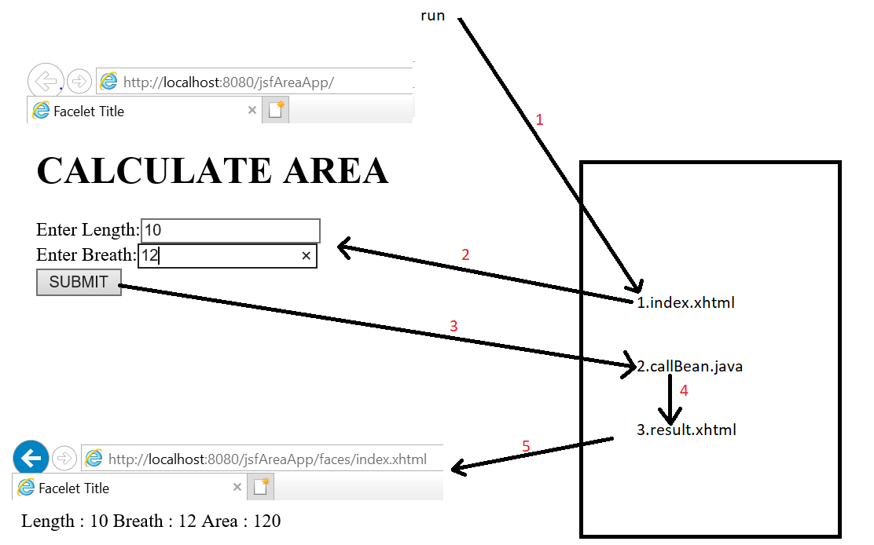
PROG 5:Create a JSF application that will calculate the area of rectangle. Make use of expression language.

Slide 42
Index.xhtml
<?xml version='1.0' encoding='UTF-8' ?>
<!DOCTYPE html>
<html xmlns="http://www.w3.org/1999/xhtml"
xmlns:h="http://xmlns.jcp.org/jsf/html">
<h:head>
<title>Facelet Title</title>
</h:head>
<h:body>
<h1>CALCULATE AREA</h1>
<h:form>
Enter Length:<h:inputText value="#{calBean.len}"/><br/>
Enter Breath:<h:inputText value="#{calBean.br}"/><br/>
<h:commandButton value="SUBMIT" action="result.xhtml"/>
</h:form>
</h:body>
</html>

Slide 43
calBean.java
import javax.annotation.ManagedBean;
import javax.enterprise.context.ApplicationScoped;
import javax.inject.Named;
@Named(value = "calBean")
@ManagedBean
@ApplicationScoped
public class calBean {
int len,br;
public calBean() {
}
public int getLen() {
return len;
}
public void setLen(int len) {
this.len = len;
}
public int getBr() {
return br;
}
public void setBr(int br) {
this.br = br;
}
public int area(){
int area = len*br;
return area;
}
}

Slide 44
Result.xhtml
<?xml version='1.0' encoding='UTF-8' ?>
<!DOCTYPE html>
<html xmlns="http://www.w3.org/1999/xhtml"
xmlns:h="http://xmlns.jcp.org/jsf/html">
<h:head>
<title>Facelet Title</title>
</h:head>
<h:body>
Length : #{calBean.len}
Breath : #{calBean.br}
Area : #{calBean.area()}
</h:body>
</html>

Slide 45
JSF Convertor Tags
JSF provides inbuilt convertors to convert its UI component's data to object used in a managed bean and vice versa. For example, these tags can convert a text into date object and can validate the format of input as well.
For these tags you need to use the following namespaces of URI in html node.
<html xmlns="http://www.w3.org/1999/xhtml" xmlns:f="http://java.sun.com/jsf/core" >

Slide 46
JSF Convertor Tags
S.N. | Tag & Description
1 | f:convertNumber Converts a String into a Number of desired format
2 | f:convertDateTime Converts a String into a Date of desired format
3 | Custom Convertor Creating a custom convertor

Slide 47
JSF Convertor Tags
1.<f:convertNumber >tag is used to convert a string value to a number of required format.
Syntax:
<f:convertNumber minFractionDigits="2" />

Slide 48
JSF Convertor Tags
S.N. | Attribute & Description
1 | type number (default), currency , or percent
2 | pattern Formatting pattern, as defined in java.text.DecimalFormat
3 | maxFractionDigits Maximum number of digits in the fractional part
4 | minFractionDigits Minimum number of digits in the fractional part
5 | maxIntegerDigits Maximum number of digits in the integer part
6 | minIntegerDigits Minimum number of digits in the integer part
7 | integerOnly True if only the integer part is parsed (default: false)

Slide 49
JSF Convertor Tags
2.<f:convertDateTime> tag is used to convert a string value to a date of required format. It also acts as a validator a required date format.
Syntax:
<f:convertDateTime pattern="dd-mm-yyyy" />

Slide 50
JSF Convertor Tags
S.N. | Attribute & Description
1 | type date (default), time, or both
2 | dateStyle default, short, medium, long, or full
3 | timeStyle default, short, medium, long, or full
4 | pattern Formatting pattern, as defined in java.text.SimpleDateFormat
5 | locale Locale whose preferences are to be used for parsing and formatting
6 | timeZone Time zone to use for parsing and formatting

Slide 51
JSF - Validation Tags
JSF provides inbuilt validators to validate its UI components. These tags can validate the length of the field, the type of input which can be a custom object.
S.No | Tag & Description
1 | f:validateLength: Validates the length of a string
2 | f:validateLongRange: Validates the range of a numeric value
3 | f:validateDoubleRange: Validates the range of a float value

Slide 52
JSF - Validation Tags
S.N. | Tag & Description
1 | f:validateLength Validates length of a string
2 | f:validateLongRange Validates range of numeric value
3 | f:validateDoubleRange Validates range of float value
4 | f:validateRegex Validate JSF component with a given regular expression.
5 | Custom Validator Creating a custom validat

Slide 53
JSF - f:validateLength
f:validateLength tag is used to validate the length of a string value in a particular range.
JSF Tag
<f:validateLength minimum = "5" maximum = "8" />
Tag Attributes
S.No | Attribute & Description
1 | minimum A String with a minimum number of characters
2 | maximum A String with a maximum number of characters

Slide 54
JSF - f:validateLongRange
f:validateLongRange tag is used to validate the long value in a particular range.
JSF Tag
Tag Attributes
<f:validateLongRange minimum = "5" maximum = "200" />
S.No | Attribute & Description
1 | minimum Minimum long value within an optional range
2 | maximum Maximum long value within an optional range

Slide 55
JSF - f:validateDoubleRange
f:validateDoubleRange tag is used to validate a value to a range of float values.
JSF Tag
Tag Attributes
<f:validateDoubleRange minimum = "1000.50" maximum = "10000.50" />
S.No | Attribute & Description
1 | minimum Minimum long value within an optional range
2 | maximum Maximum long value within an optional range

Slide 56
JSF - f:validateRegex
<f:validateRegex> tag is used to validate a string value to a required format.
Syntax:
<f:validateRegex pattern="((?=.*[a-z]).{6,})" />

Slide 57
Custom validator
Step No. | Description
1 | Create a validator class by implementing javax.faces.validator.Validator interface.
2 | Implement validate() method of above interface.
3 | Use Annotation @FacesValidator to assign a unique id to the custom validator.
We can create our own Custom validator in JSF.
Defining a custom validator in JSF is a three step process

Slide 58
Step 1: Create a validator class : UrlValidator.java public class UrlValidator implements Validator { ... }
Step 2: Implement Validator interface methods :
UrlValidator.java
public class UrlValidator implements Validator { @Override public void validate(FacesContext
facesContext, UIComponent component, String value) throws ValidatorException
{ ... }
}

Slide 59
Step 3: Annotate to register the validator :
UrlValidator.java
@FacesValidator("com.tutorialspoint.test.UrlVali dator") public class UrlValidator implements Validator { }
Use the validator in JSF page
<h:inputText id="urlInput" value="#{userData.data}" label="URL" >
<f:validator validatorId="com.UrlValidator" />
</h:inputText>

Slide 60
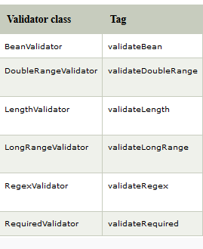
JSF Validation Tags
JavaServer Faces technology provides a set of standard classes and associated tags that you can use to validate elements data.

Slide 61
JSF Validation Tags (cont.)
Validator class | Tag | Function
BeanValidator | validateBean | It is used to registers a bean validator for the component.
DoubleRangeValidator | validateDoubleRange | It is used to check whether the local value of a component is within a certain range or not. The value must be floating-point or convertible to floating-point.
LengthValidator | validateLength | It is used to check whether the length of a component's local value is within a certain range or not. The value must be a java.lang.String.
LongRangeValidator | validateLongRange | It is used to check whether the local value of a component is within a certain range or not. The value must be any numeric type or String that can be converted to a long.
RegexValidator | validateRegex | It is used to check whether the local value of a component is a match against a regular expression from the java.util.regex package or not.
RequiredValidator | validateRequired | It is used to ensure that the local value is not empty on an EditableValueHolder component.

Slide 62
JSF FACELETS TAGS:
JSF provides special tags to create common layout for a web application called facelets tags. These tags provide flexibility to manage common parts of multiple pages at one place.
For these tags, you need to use the following namespaces of URI in html node
<html xmlns = "http://www.w3.org/1999/xhtml"
xmlns:ui = "http://java.sun.com/jsf/facelets" >

Slide 63
JSF FACELETS TAGS:
It is a light weight page declaration language which is used to build JavaServer Faces views using HTML style.
It includes the following features:
It uses XHTML for creating web pages.
It supports Facelets tag libraries in addition to JavaServer Faces and JSTL tag libraries.
It supports the Expression Language (EL).
It uses templating for components and pages.

Slide 64
Advantages of Facelets
It supports code reusability through templating and composite components.
It provides functional extensibility of components and other server-side objects through customization.
Faster compilation time.
It validates expression language at compile-time.
High-performance rendering.

Slide 65
FACELET TAGS
S.N. | Tag & Description
1 | Templates We'll demonstrate how to use templates using following tags <ui:insert> <ui:define> <ui:include> <ui:composition>
2 | Parameters We'll demonstrate how to pass parameters to a template file using following tag <ui:param>
3 | Custom We'll demonstrate how to create custom tags.
4 | Remove We'll demonstrate capability to remove JSF code from generated HTML page.

Slide 66
FOUR FACELET TAGS USED TO CREATE THE TEMPLATE:
S.No | Tag & Description
1 | ui:insert Used in template file. It defines contents to be placed in a template. ui:define tag can replaced its contents.
2 | ui:define Defines the contents to be inserted in a template.
3 | ui:include Includes contents of one xhtml page into another xhtml page.
4 | ui:composition Loads a template using template attribute. It can also define a group of components to be inserted in xhtml page.

Slide 67
Creating Template steps
Step 1: Create Header file: header.xhtml
Use ui:composition tag to define a default content of Header section.
Code:
<ui:composition>
<h1>Default Header</h1>
</ui:composition>

Slide 68
Step 2: Create Footer file: footer.xhtml
Use ui:composition tag to define a default content of Footer section.
<ui:composition> <h1>Default Footer</h1>
</ui:composition>
Step 3: Create Content file: contents.xhtml
Use ui:composition tag to define a default content of Content section.
<ui:composition> <h1>Default Contents</h1>
</ui:composition>

Slide 69
Step 4: Create a Template: common.xhtml
Use ui:insert and ui:include tag to include header/footer and content file in template file. Name each section
in ui:insert tag.
name attribute of ui:insert tag will be used to replace contents of corresponding section.
Code:
<h:body>
<ui:insert name="header" >
<ui:include src="header.xhtml" /> </ui:insert>
<ui:insert name="content" >
<ui:include src="contents.xhtml" />
</ui:insert>
<ui:insert name="footer" >
<ui:include src="footer.xhtml" />
</ui:insert> </h:body>

Slide 70
2.Using ui:param tag, we can pass parameters to template file or an included file
Example:
<ui:insert name="header" >
<ui:include src="/templates/header.xhtml" >
<ui:param name="defaultHeader" value="Default Header" /> </ui:include>
</ui:insert>

Slide 71
3.ui:remove tag is used the prevent the JSF specific code to be rendered on client side. It is used especially to prevent commented out code to be rendered on client side.
Example:
<ui:remove>
<h:commandButton value="Ok" />
</ui:remove>

Slide 72
JSF Event Handling
When a user clicks a JSF button or link or changes any value in text field, JSF UI component fires event which will be handled by the the application code.
To handle such event, event handler are to be registered in the application code or managed bean.
When a UI component checks that a user event has happened, it creates an instance of the corresponding event class and adds it to an event list.
Then, Component fires the event, i.e., checks the list of listeners for that event and call the event notification method on each listener or handler.
JSF also provide system level event handlers which can be used to do some tasks when application starts or is stopping.

Slide 73
S.N. | Event Handlers & Description
1 | valueChangeListener Value change events get fired when user make changes in input components.
2 | actionListener Action events get fired when user clicks on a button or link component.
3 | Application Events Events firing during JSF lifecycle: PostConstructApplicationEvent, PreDestroyApplicationEvent , PreRenderViewEvent.

Slide 74
Managed Beans

Slide 75
Managed Beans
Managed beans are JavaBeans which:
Provide the logic for initializing and controlling JSF components
Data binding, action listeners, validation, conversion, navigation, etc.
Manage data across page requests, user sessions, or the application as a whole
Created by JSF and stored within the request, session or application
Also called "backing beans"

Slide 76
Mapping Managed Beans
Managed beans are mapped in the
faces-config.xml
<managed-bean>
<managed-bean-name>someName</managed-bean-name>
<managed-bean-class>package.BeanClass</managed-bean- class>
<managed-bean-scope>session</managed-bean-scope>
</managed-bean>

Slide 77
Mapping Elements
<managed-bean> – enclosing element
<managed-bean-name> – this element’s value is the identifier used for the bean in our JSP pages
<managed-bean-class> – the fully qualified name of the class of the bean
<managed-bean-scope> – the bean’s scope (request, session, application, none)

Slide 78


Binding Values
Managed beans and their properties can be used as values for the components
– Example: we have a session scoped managed bean of class UserBean with property userName we can do
<h:inputText id="userNameInput" value="#{userBean.userName}" />
– JSF will automatically apply component entered value to the userName property and vice versa

Slide 79

JSF Navigation Model

Slide 80





What Is Navigation?
Navigation is a set of rules for choosing the next page to be displayed
Applied after a button or hyperlink is clicked
The selection of the next page is determined by:
The page that is currently displayed
The action method invoked by the action property of the component that generated the event
An outcome string that was returned by the action method or passed from the component

Slide 81










Navigation Elements in faces-config.xml
<from-view-id> element defines the source page.
– May be a pattern. For example /*. This will cause all JSF pages to redirect to some view on given outcome.
<from-outcome> element defines the logical outcome as specified in the action attribute of the event source
<to-view-id> element defines the page to be displayed when the specified outcome is returned
<from-action> element refers to an action method that returns a String, which is the logical outcome

Slide 82



Navigation Rules – Example
<navigation-rule>
<from-view-id>/login-demo.xhtml</from-view-id>
<navigation-case>
<from-outcome>success</from-outcome>
<to-view-id>/welcome.xhtml</to-view-id>
</navigation-case>
</navigation-rule>
<navigation-rule>
<from-view-id>/login-demo.xhtml</from-view-id>
<navigation-case>
<from-outcome>failed</from-outcome>
<to-view-id>/login-failed.xhtml</to-view-id>
</navigation-case>
</navigation-rule>

Slide 83









Action Attribute in JSF Form
To specify what to be the form outcome you can
– Provide a constant string as action attribute of an event source
<h:commandButton value="Next Page" action="nextPage" />
Provide a managed bean method with no parameters which returns String
Using this approach you can add some logic in this method that returns different result in different situations
<h:commandButton value="Login" action="#{userBean.login}" />

Slide 84
JSF Database Access

Slide 85
Program 6: DATABASE ACCESS
Index.xhtml
<?xml version='1.0' encoding='UTF-8' ?>
<!DOCTYPE html>
<html xmlns="http://www.w3.org/1999/xhtml"
xmlns:h="http://xmlns.jcp.org/jsf/html">
<h:head>
<title>Facelet Title</title>
</h:head>
<h:body>
<h1>JDBC JSF EXAMPLE</h1>
<h:form>
USER NAME: <h:inputText id="uname“ value = "#{user.uname}"/>
EMAIL: <h:inputText id="email“ value = "#{user.email}"/>
<h:commandButton action = "#{user.submit()}" value = "SUBMIT"/>
</h:form>
</h:body>
</html>

Slide 86
Program 6: DATABASE ACCESS
response.xhtml
<?xml version='1.0' encoding='UTF-8' ?>
<!DOCTYPE html>
<html xmlns="http://www.w3.org/1999/xhtml"
xmlns:h="http://xmlns.jcp.org/jsf/html">
<h:head>
<title>Facelet Title</title>
</h:head>
<h:body>
Hello <h:outputText value="#{user.uname}"/>
Your Record has been Saved Successfully!
</h:body>
</html>

Slide 87
Program 6: DATABASE ACCESS
User.java
import java.sql.*;
import javax.inject.Named;
import javax.annotation.ManagedBean;
import javax.enterprise.context.ApplicationScoped;
@Named(value = "user")
@ManagedBean
@ApplicationScoped
public class User {
String uname,email;
public User() {
}
public String getUname() {
return uname;
}
public void setUname(String uname) {
this.uname = uname;
}
public String getEmail() {
return email;
}
public void setEmail(String email) {
this.email = email;
}

Slide 88
Program 6: DATABASE ACCESS
User.java
public boolean save(){
int result = 0;
try{
Class.forName("com.mysql.jdbc.Driver");
Connection con = DriverManager.getConnection( "jdbc:mysql://localhost:3306/Emp","root","");
PreparedStatement stmt = con.prepareStatement("insert into user(name,email) values(?,?)");
stmt.setString(1, this.getUname());
stmt.setString(2, this.getEmail());
result = stmt.executeUpdate();
}catch(Exception e){
System.out.println(e);
}
if(result == 1){
return true;
}else
return false;
}
public String submit(){
if(this.save()){
return "response.xhtml";
}else{
return "index.xhtml";
}
}
}

Slide 89
JSF Database Access Example Links
Example 1
https://www.javatpoint.com/jsf-jdbc-connectivity
Example 2 – CRUD Application
https://www.javatpoint.com/jsf-crud-example
Example 3
https://www.tutorialspoint.com/jsf/jsf_display_datatable.htm

Slide 90
JSF PrimeFaces
It is an UI (User Interface) library for JSF (JavaServer Faces) based applications.
It is designed and developed by PrimeTek.
It is Cross-platform, open source and written in Java programing language.
It provides rich support of UI components, built-in ajax support, themes etc.
It has became popular and supported by Oracle.
It is default library in NetBeans IDE.

Slide 91
JSF PrimeFaces Features
Rich UI Components
Ajax Support
Push Support
Dialog Suppport
Client Side Validation
Mobile UI kit
Skinning Framework

Slide 92
JSF PrimeFaces Features (cont.)
Rich UI Components
It provides over 100 UI (User Interface) components. We can use that to create interective interface for JSF application. It includes HtmlEditor, Dialog, AutoComplete, Signature etc.
Ajax Support
Primefaces provides built-in Ajax support. We can use it to perform Ajax call for the JSF application. It provides Ajax components like: counter, listener, event, poll etc.
PrimeFaces Ajax Javascript API is powered by jQuery and optimized for JSF. Whole API consists of properly namespaced simple javascript functions PrimeFaces.ajax.Request, PrimeFaces.ajax.Response.
Push Support
It provides Atmosphere framework that provides us push support. The Atmosphere Framework is the most popular asynchronous application development framework for enterprise Java. PrimeFaces Push 2.0 is based on Atmosphere as its predecessor and follows an annotation based approach this time.

Slide 93
JSF PrimeFaces Features (cont.)
Dialog Support
PrimeFaces provides Dialog Framework which is used to open an external xhtml page in a dialog that is generated dynamically on runtime. The RequestContext provides methods to open and close dialog.
Client Side Validation
PrimeFaces provides the most advanced Client Side Validation for JavaServer Faces and Java EE. It is used to validate data at client side. It is compatible with Server Side Implementation and provides Advanced Bean Validation Integration.

Slide 94
JSF PrimeFaces Features (cont.)
Mobile UI Kit
It provides a mobile UI kit to create JSF application for mobile phones. It is default in the library. So, does not require any additional downloading. It is built on top of jQuery Mobile.
It includes various features popular PrimeFaces components, ajax framework extensions, mobile ajax behavior events, integrated navigation model, lazy loading of pages, responsive widgets etc.
Skining Framework
It provides lots of built-in themes and designer tools for visual themes. PrimeFaces is integrated with powerful ThemeRoller CSS Framework. Currently there are many pre-designed themes that we can preview and download from PrimeFaces theme gallery.

Slide 95
More on PrimeFaces
Link 1
https://www.javatpoint.com/primefaces-configuration
Link 2
https://www.javatpoint.com/primefaces-ajax

